Slide 1
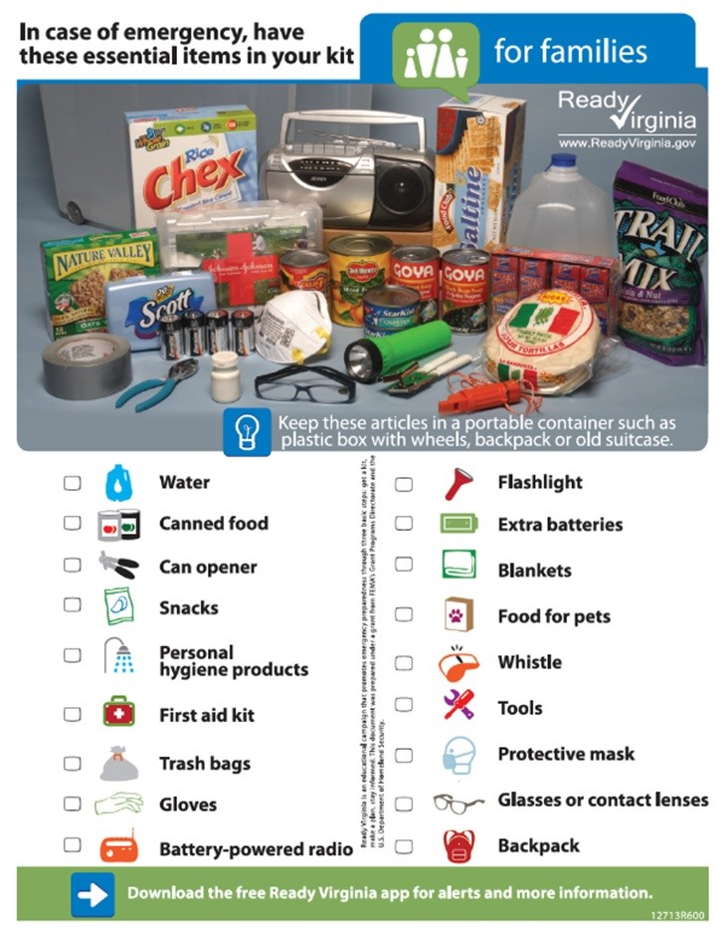
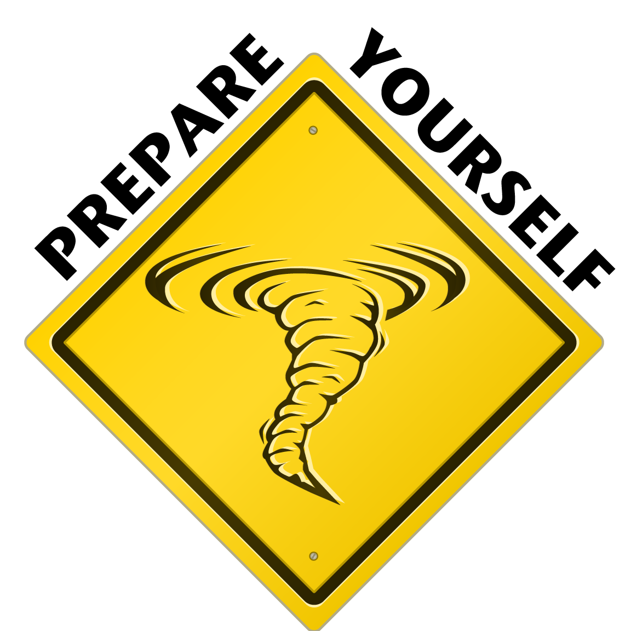
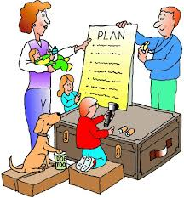

Be & Stay Prepared!!

Slide 2
Notes:
<iframe width="560" height="315" src="https://www.youtube.com/embed/dvSk5nVgfXg" frameborder="0" allowfullscreen></iframe>

Slide 3
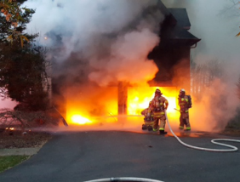
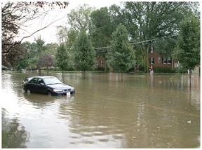
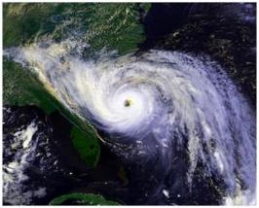
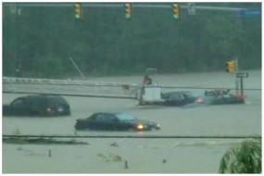
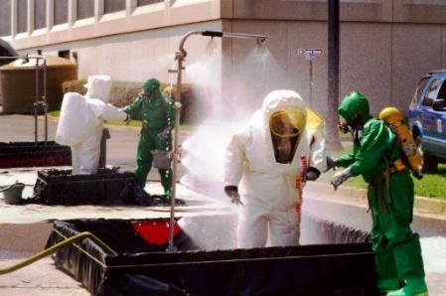
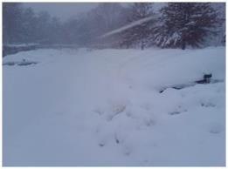
Types of Hazards

Slide 4
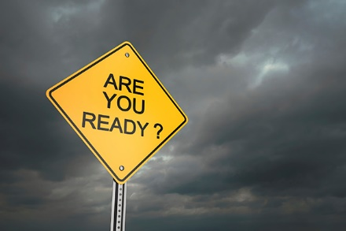
Why Prepare?
We may not be at home
We may have family or friends staying with us
We may be in a new location

Slide 5
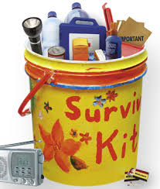
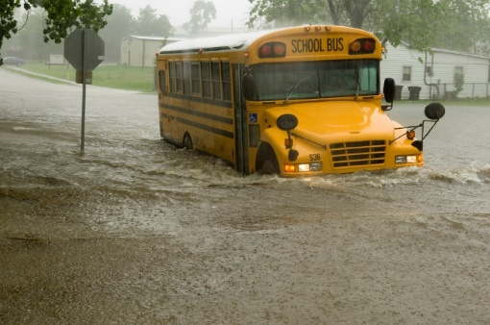
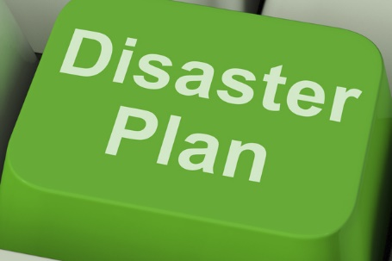

What can we do?
Make a Kit
Make a Plan
Stay Informed

Slide 6
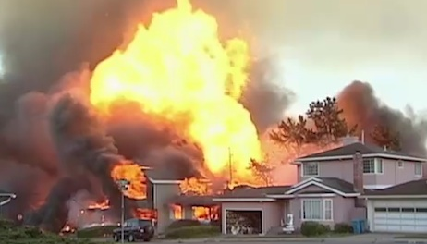
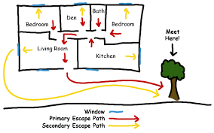
What is a Family Emergency Plan?
A family emergency plan tells everyone in the household what they will do during an emergency. Having a plan reduces the stress of coping with the aftermath of a disaster.

Slide 7
Why should my family have a plan?
To plan for all of our family members and visitors before an emergency. This ensures we all know how to get out of our homes safely, thus saving lives. We can also ensure we have access to important information and documents.
The plan should be updated annually or whenever there are changes in the family or household.
Practice your plan!! The worst kind of plan is the one that sits on a shelf and is never practiced. Take time to teach your family and grandchildren how to:
Open window screens
Drop, cover and hold on to heavy furniture
Escape from your home
Go to shelter in place locations
After practicing, improve your plan

Slide 8
Making a Family Emergency Plan
Discuss
Communicate
Meeting Places
Special Needs
Notes:
Discuss preparedness with your family; discuss with neighbors!
Identify an out-of-state contact in case you are separated. Long-distance calls may work when local calls do not
Teach grandchildren how and when to call 911; and how to use a cell phone
Post emergency contact numbers near phones in your home
Determine two escape routes from each room in your home
Pick three places to meet – One right outside your home in case of a sudden emergency, pick a location in your neighborhood if your property isn’t safe and a regional meeting place if you can’t return home

Slide 9
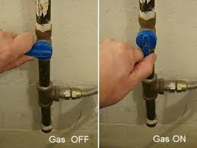
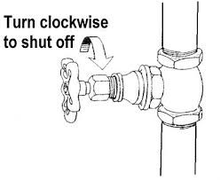
Home Layout Diagram
Draw a layout or include a floorplan of the dwelling, including locations of utility shutoffs and safety equipment like fire extinguishers, disaster supplies. Consider including diagrams of escape routes and meeting locations.
Take Pictures of your home, inside and out!

Slide 10
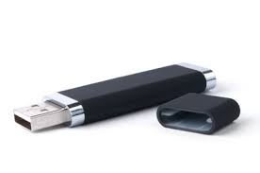
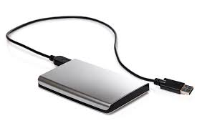
Important Documents
Try to have originals of important documents (e.g. birth certificates, marriage license, wills, power of attorney, advanced directives, etc.); or have pertinent information of where the documents came from or are located (e.g. which courthouse, which County, City, State, etc.)
Ensure banking / deposits occur online (not through mail)
  Social Security benefits / retirement income
Grab & Go Files in a Binder OR External Drive (e.g. thumb drive or hard drive) or keep in a waterproof pouch
  Home / Life / Pets
  Professional / Business
  Insurance
  Vehicles

Slide 11
Resource:
Emergency Financial First Aid Kit (EFFAK)
The FEMA EFFAK is a tool to collect and secure important personal information in a central location
The EFFAK is a useful tool for:
  all income levels and
  whether you live alone or with many others
Available online at www.ready.gov/financialpreparedness or www.operationhope.org; or by calling FEMA at (800) 480–2520 (ask for document #532)

Slide 12
Make a Kit
Water—one gallon per person, per day (3-day supply for evacuation, 2-week supply for home)
Food—non-perishable, easy-to-prepare items (3-day supply for evacuation, 2-week supply for home)
Flashlights; Multi-purpose tool; Extra batteries
Battery-powered or hand-crank radio
First aid kit
Check kit every 6 months & Test supplies

Slide 13
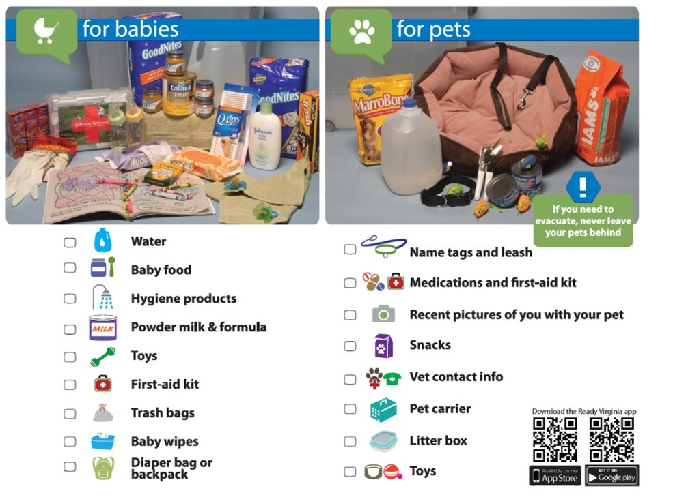
Make a Kit
Medications (7-day supply)
Sanitation and personal hygiene items
Cell phone with chargers
Family and emergency contact information
Extra cash (at least $100/person)
If someone in your home is dependent on electric-powered, life-sustaining equipment, remember to include backup power in your emergency or evacuation plan
Don’t forget to include your Important Document Folder / External Drive
Check Expiration Dates!

Slide 14
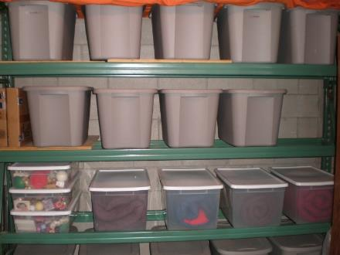
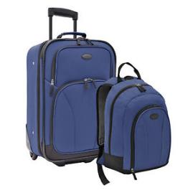

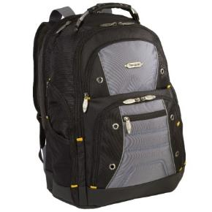
Kit Containers & Storage
How are they stored?
  Cool, dry place
  Readily accessible
Is your kit easy to carry or move?
  Containers / bags with wheels
  Low weight

Slide 15
Stay Informed
Emergency information website or blog
http://www.fairfaxva.gov/government/emergency-management
Emergency alerting system
Monitor local news / NOAA weather radio
Other sources of information:
  Local utility company websites
  State agency websites (VDOT for example)
  Social media – trusted sources!

Slide 16
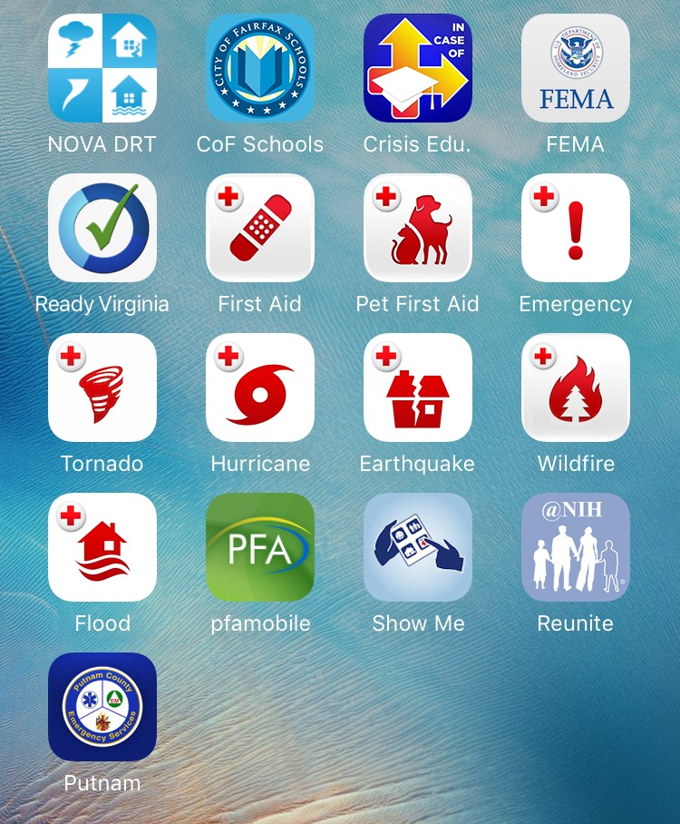
Emergency Apps

Slide 17
Important phone numbers
EMERGENCIES | 911
City of Fairfax Emergency Management | 703-385-4856
Crisislink Hotline | 703-527-4077
Fairfax County Health Department | 703-246-7100
City of Fairfax Police – Non-emergency | 703-385-7924
City of Fairfax Fire Department - Non-emergency | 703-385-7940
Fairfax Volunteer Fire Department | 703-385-7877
The Virginia Relay Center - TTY | 711
The Virginia Relay Center - Voice | 711
City of Fairfax Police Department - Emergency | 911 or 703-591-5511
Salvation Army | 703-385-8700
American Red Cross | 1-866-438-4636
Department of Homeland Security | 1-800-BE-READY
Center for Disease Control | 1-800-311-3435
National Weather Service | 703-260-0809
FEMA Disaster Assistance Hotline | 1-800-621-3362
FEMA Disaster Assistance Hotline - TTY | 1-800-462-7585
FEMA False Claim Reporting | 1-800-323-9603

Slide 18

Resources
City of Fairfax Office of Emergency Management
http://www.fairfaxva.gov/government/emergency-management
Fairfax City Alert
http://fairfaxva.gov/about-us/fairfax-city-alert
Ready Virginia
http://www.vaemergency.gov/readyvirginia
Individuals with Disabilities, Access and Functional Needs
https://www.ready.gov/individuals-access-functional-needs
Family Communications Plan
http://www.ready.gov/make-a-plan
Ready.Gov (FEMA) for Seniors
https://www.ready.gov/seniors
Get Involved!
Find Out More!

