Slide 1
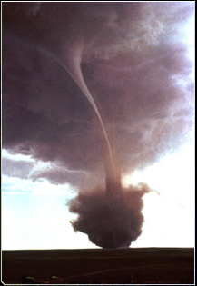
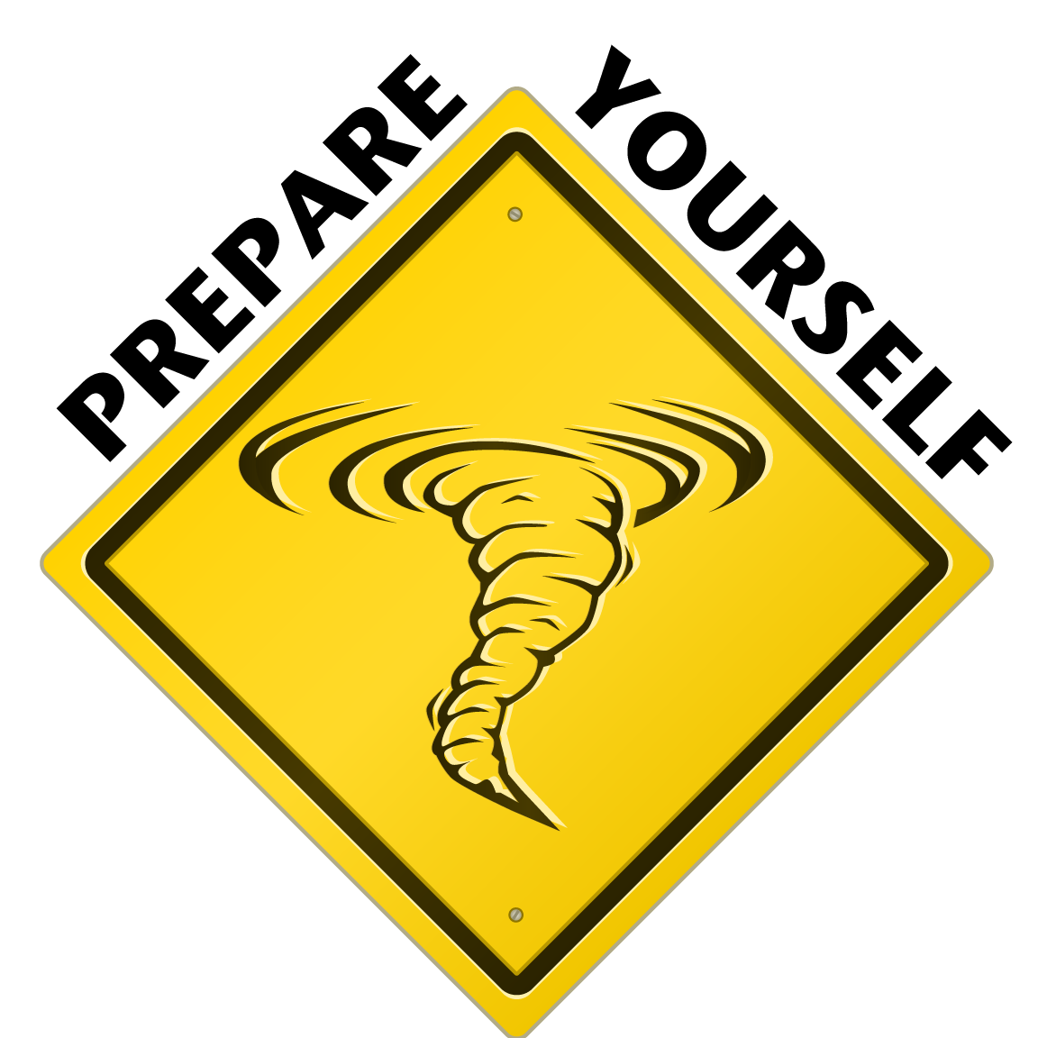
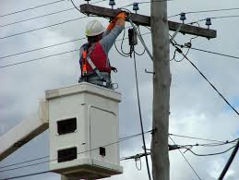

Brown Bag Session
Tornadoes & Power Outages

Slide 2
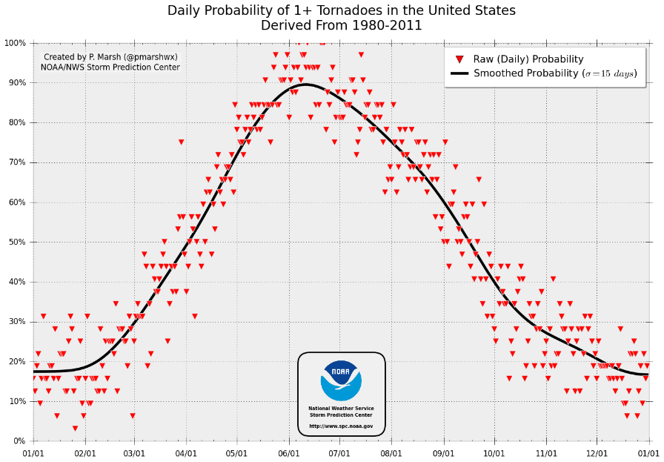
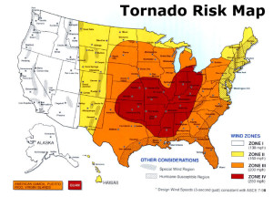

PREPAREDNESS
Tornadoes
Power Outages
Resources

Slide 3

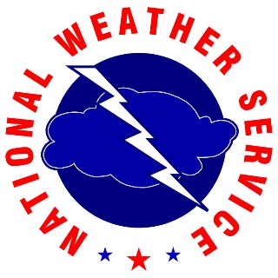
Tornadoes
What are Tornadoes?
  A tornado is a narrow, violently rotating column of air that extends from the base of a thunderstorm to the ground. Because wind is invisible, it is hard to see a tornado unless it forms a condensation funnel made up of water droplets, dust and debris. Tornadoes are the most violent of all atmospheric storms.
Where do Tornadoes Occur?
  Tornadoes occur in many parts of the world, including Australia, Europe, Africa, Asia, and South America. Even New Zealand reports about 20 tornadoes each year. Two of the highest concentrations of tornadoes outside the U.S. are Argentina and Bangladesh.
When are Tornadoes Most Likely?
  Tornado season usually refers to the time of year the U.S. sees the most tornadoes. The peak “tornado season” for the Southern Plains is during May into early June. On the Gulf coast, it is earlier during the spring. In the northern plains and upper Midwest, tornado season is in June or July. But, remember, tornadoes can happen at any time of year. Tornadoes can also happen at any time of day or night, but most tornadoes occur between 4–9 p.m.
Notes:
What is a tornado?
A tornado is a narrow, violently rotating column of air that extends from the base of a thunderstorm to the ground. Because wind is invisible, it is hard to see a tornado unless it forms a condensation funnel made up of water droplets, dust and debris. Tornadoes are the most violent of all atmospheric storms.
Where do tornadoes occur?
Tornadoes occur in many parts of the world, including Australia, Europe, Africa, Asia, and South America. Even New Zealand reports about 20 tornadoes each year. Two of the highest concentrations of tornadoes outside the U.S. are Argentina and Bangladesh.
How many tornadoes occur in the U.S. each year?
About 1,200 tornadoes hit the U.S. yearly. Since official tornado records only date back to 1950, we do not know the actual average number of tornadoes that occur each year. Plus, tornado spotting and reporting methods have changed a lot over the last several decades.
Where is tornado alley?
Tornado Alley is a nickname invented by the media for a broad area of relatively high tornado occurrence in the central U.S. Various Tornado Alley maps look different because tornado occurrence can be measured many ways: by all tornadoes, tornado county-segments, strong and violent tornadoes only, and databases with different time periods. Please remember, violent or killer tornadoes do happen outside “Tornado Alley” every year.
When are tornadoes most likely?
Tornado season usually refers to the time of year the U.S. sees the most tornadoes. The peak “tornado season” for the Southern Plains is during May into early June. On the Gulf coast, it is earlier during the spring. In the northern plains and upper Midwest, tornado season is in June or July. But, remember, tornadoes can happen at any time of year. Tornadoes can also happen at any time of day or night, but most tornadoes occur between 4–9 p.m.

Slide 4
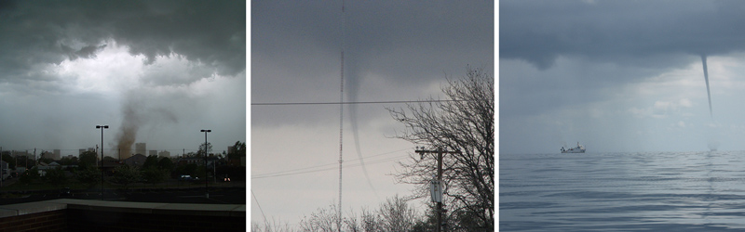
Non-supercell tornadoes include (L-R):
Gustnadoes, whirls of dust or debris at or near the ground with no condensation funnel, which form along the gust front of a storm.
Landspouts, narrow, rope-like condensation funnels that form while the thunderstorm cloud is still growing and there is no rotating updraft. The spinning motion originates near the ground.
Waterspouts, similar to landspouts, except they occur over water.

Slide 5
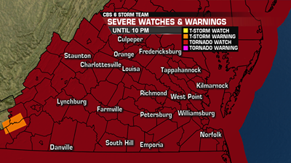
Understanding Critical Information
Tornado Watch
A Tornado WATCH is issued by the NOAA Storm Prediction Center meteorologists who watch the weather 24/7 across the entire U.S. for weather conditions that are favorable for tornadoes. A watch can cover parts of a state or several states. Watch and prepare for severe weather and stay tuned to NOAA Weather Radio to know when warnings are issued.
Tornado Warning
A Tornado WARNING is issued by your local NOAA National Weather Service Forecast Office meteorologists who watch the weather 24/7 over a designated area. This means a tornado has been reported by spotters or indicated by radar and there is a serious threat to life and property to those in the path of the tornado. ACT now to find safe shelter! A warning can cover parts of counties or several counties in the path of danger.
Notes:
What is the difference between a Tornado WATCH and a Tornado WARNING?
A Tornado WATCH is issued by the NOAA Storm Prediction Center meteorologists who watch the weather 24/7 across the entire U.S. for weather conditions that are favorable for tornadoes. A watch can cover parts of a state or several states. Watch and prepare for severe weather and stay tuned to NOAA Weather Radio to know when warnings are issued.
A Tornado WARNING is issued by your local NOAA National Weather Service Forecast Office meteorologists who watch the weather 24/7 over a designated area. This means a tornado has been reported by spotters or indicated by radar and there is a serious threat to life and property to those in the path of the tornado. ACT now to find safe shelter! A warning can cover parts of counties or several counties in the path of danger.
How is tornado strength rated?
The most common and practical way to determine the strength of a tornado is to look at the damage it caused. From the damage, we can estimate the wind speeds. An “Enhanced Fujita Scale” was implemented by the National Weather Service in 2007 to rate tornadoes in a more consistent and accurate manner. The EF-Scale takes into account more variables than the original Fujita Scale (F-Scale) when assigning a wind speed rating to a tornado, incorporating 28 damage indicators such as building type, structures and trees. For each damage indicator, there are 8 degrees of damage ranging from the beginning of visible damage to complete destruction of the damage indicator. The original F-scale did not take these details into account. The original F-Scale historical data base will not change. An F5 tornado rated years ago is still an F5, but the wind speed associated with the tornado may have been somewhat less than previously estimated. A correlation between the original F-Scale and the EF-Scale has been developed. This makes it possible to express ratings in terms of one scale to the other, preserving the historical database.
How do tornadoes form?
The truth is that we don't fully understand. The most destructive and deadly tornadoes occur from supercells, which are rotating thunderstorms with a well-defined radar circulation called a mesocyclone. (Supercells can also produce damaging hail, severe non-tornadic winds, unusually frequent lightning, and flash floods.) Tornado formation is believed to be dictated mainly by things which happen on the storm scale, in and around the mesocyclone. Recent theories and results from the VORTEX2 program suggest that once a mesocyclone is underway, tornado development is related to the temperature differences across the edge of downdraft air wrapping around the mesocyclone. Mathematical modeling studies of tornado formation also indicate that it can happen without such temperature patterns; and in fact, very little temperature variation was observed near some of the most destructive tornadoes in history on 3 May 1999. We still have lots of work to do.
What do storm spotters look for when trying to identify a tornado or a dangerous storm?
Inflow bands are ragged bands of low cumulus clouds extending from the main storm tower usually to the southeast or south. The presence of inflow bands suggests that the storm is gathering low-level air from several miles away. If the inflow bands have a spiraling nature to them, it suggests the presence of rotation.
The beaver's tail is a smooth, flat cloud band extending from the eastern edge of the rain-free base to the east or northeast. It usually skirts around the southern edge of the precipitation area. It also suggests the presence of rotation.
A wall cloud is an isolated cloud lowering attached to the rain-free base of the thunderstorm. The wall cloud is usually to the rear of the visible precipitation area.
A wall cloud that may produce a tornado usually exists for 10–20 minutes before a tornado appears. A wall cloud may also persistently rotate (often visibly), have strong surface winds flowing into it, and may have rapid vertical motion indicated by small cloud elements quickly rising into the rain-free base.
As the storm intensifies, the updraft draws in low-level air from several miles around. Some low-level air is pulled into the updraft from the rain area. This rain-cooled air is very humid; the moisture in the rain-cooled air quickly condenses below the rain-free base to form the wall cloud.
The rear flank downdraft (RFD) is a downward rush of air on the back side of the storm that descends along with the tornado. The RFD looks like a “clear slot” or “bright slot” just to the rear (southwest) of the wall cloud. It can also look like curtains of rain wrapping around the cloud base circulation. The RFD causes gusty surface winds that occasionally have embedded downbursts. The rear flank downdraft is the motion in the storm that causes the hook echo feature on radar.
A condensation funnel is made up of water droplets and extends downward from the base of the thunderstorm. If it is in contact with the ground it is a tornado; otherwise it is a funnel cloud. Dust and debris beneath the condensation funnel confirm a tornado's presence.
A excellent comprehensive list of questions and answers about tornadoes can be found here: http://www.spc.noaa.gov/faq/tornado/

Slide 6

Notes:
<iframe width="560" height="315" src="https://www.youtube.com/embed/x3V3HZBs1Y4" frameborder="0" allowfullscreen></iframe>

Slide 7
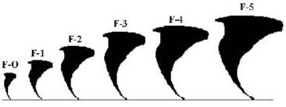
How to Prepare
Source: Ready.gov
Indoors
outdoors
Go to a pre-designated area such as a safe room, basement, storm cellar, or the lowest building level. If there is no basement, go to the center of a small interior room on the lowest level (closet, interior hallway) away from corners, windows, doors, and outside walls.
Put as many walls as possible between you and the outside. Get under a sturdy table and use your arms to protect your head and neck
In a high-rise building, go to a small interior room or hallway on the lowest floor possible
Put on sturdy shoes
Do not open windows
Immediately get into a vehicle, buckle your seat belt and try to drive to the closest sturdy shelter. If your vehicle is hit by flying debris while you are driving, pull over and park.
Take cover in a stationary vehicle. Put the seat belt on and cover your head with your arms and a blanket, coat or other cushion if possible.
Lie in an area noticeably lower than the level of the roadway and cover your head with your arms and a blanket, coat or other cushion if possible.

Slide 8
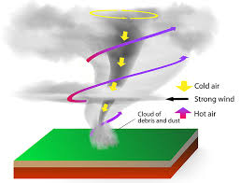
In all Situations
Source: Ready.gov
Do not get under an overpass or bridge. You are safer in a low, flat location.
Never try to outrun a tornado in urban or congested areas in a car or truck. Instead, leave the vehicle immediately for safe shelter.
Watch out for flying debris. Flying debris from tornadoes causes most fatalities and injuries.

Slide 9
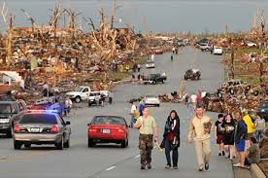
Building a Safe Room
The purpose of a safe room or a wind shelter is to provide a space where you and your family can seek refuge that provides a high level of protection. You can build a safe room in one of several places in your home.
Your basement
Atop a concrete slab-on-grade foundation or garage floor
An interior room on the first floor.
Safe rooms built below ground level provide the greatest protection, but a safe room built in a first-floor interior room also can provide the necessary protection.
Notes:
Extreme windstorms in many parts of the country pose a serious threat to buildings and their occupants. Your residence may be built "to code" but that does not mean it can withstand winds from extreme events such as tornadoes and major hurricanes. The purpose of a safe room or a wind shelter is to provide a space where you and your family can seek refuge that provides a high level of protection. You can build a safe room in one of several places in your home.
Your basement
Atop a concrete slab-on-grade foundation or garage floor.
An interior room on the first floor.
Safe rooms built below ground level provide the greatest protection, but a safe room built in a first-floor interior room also can provide the necessary protection. Below-ground safe rooms must be designed to avoid accumulating water during the heavy rains that often accompany severe windstorms.
To protect its occupants, a safe room must be built to withstand high winds and flying debris, even if the rest of the residence is severely damaged or destroyed. Consider the following when building a safe room:
The safe room must be adequately anchored to resist overturning and uplift.
The walls, ceiling and door of the shelter must withstand wind pressure and resist penetration by windborne objects and falling debris.
The connections between all parts of the safe room must be strong enough to resist the wind.
Sections of either interior or exterior residence walls that are used as walls of the safe room must be separated from the structure of the residence so that damage to the residence will not cause damage to the safe room.

Slide 10
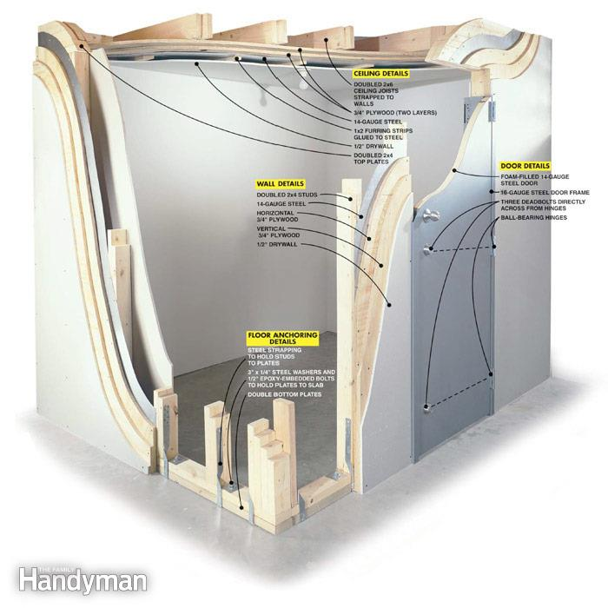
Building a Safe Room
The safe room must be adequately anchored to resist overturning and uplift.
The walls, ceiling and door of the shelter must withstand wind pressure and resist penetration by windborne objects and falling debris.
The connections between all parts of the safe room must be strong enough to resist the wind.
Sections of either interior or exterior residence walls that are used as walls of the safe room must be separated from the structure of the residence so that damage to the residence will not cause damage to the safe room.
Notes:
Extreme windstorms in many parts of the country pose a serious threat to buildings and their occupants. Your residence may be built "to code" but that does not mean it can withstand winds from extreme events such as tornadoes and major hurricanes. The purpose of a safe room or a wind shelter is to provide a space where you and your family can seek refuge that provides a high level of protection. You can build a safe room in one of several places in your home.
Your basement
Atop a concrete slab-on-grade foundation or garage floor.
An interior room on the first floor.
Safe rooms built below ground level provide the greatest protection, but a safe room built in a first-floor interior room also can provide the necessary protection. Below-ground safe rooms must be designed to avoid accumulating water during the heavy rains that often accompany severe windstorms.
To protect its occupants, a safe room must be built to withstand high winds and flying debris, even if the rest of the residence is severely damaged or destroyed. Consider the following when building a safe room:
The safe room must be adequately anchored to resist overturning and uplift.
The walls, ceiling and door of the shelter must withstand wind pressure and resist penetration by windborne objects and falling debris.
The connections between all parts of the safe room must be strong enough to resist the wind.
Sections of either interior or exterior residence walls that are used as walls of the safe room must be separated from the structure of the residence so that damage to the residence will not cause damage to the safe room.

Slide 11
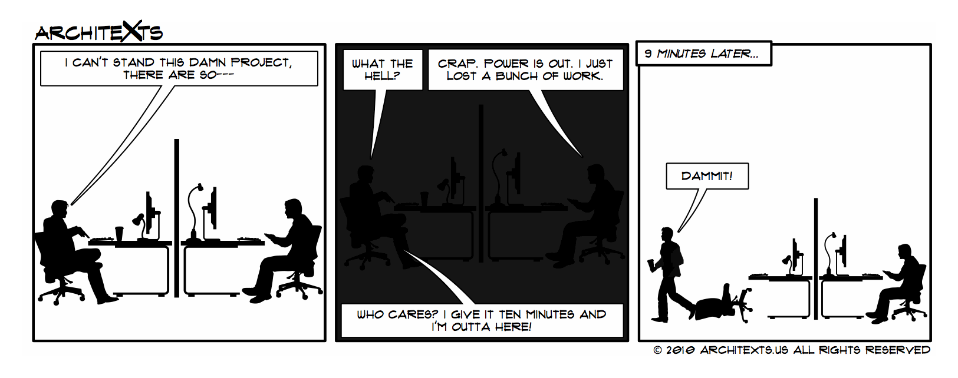
Power Outages

Slide 12
Power Outages: Before
Source: redcross.org
To help preserve food during a power outage, keep supplies on hand:
One or more coolers—Inexpensive Styrofoam coolers work well
Ice—Surrounding your food with ice in a cooler or in the refrigerator will keep food colder for a longer period of time during a prolonged blackout
A digital quick-response thermometer— With these thermometers you can quickly check the internal temperatures of food to ensure they are cold enough to use safely
Create or check your Emergency Kit!

Slide 13
Emergency Kits
Source: redcross.org
Water—one gallon per person, per day (3-day supply for evacuation, 2-week supply for home)
Food—non-perishable, easy-to-prepare items (3-day supply for evacuation, 2-week supply for home)
Flashlight (Do not use candles during a power outage due to the extreme risk of fire.)
Battery-powered or hand-crank radio (NOAA Weather Radio, if possible)
Multi-purpose tool; Extra batteries
First aid kit
Medications (7-day supply) and required medical items
Sanitation and personal hygiene items
Copies of personal documents (medication list and pertinent medical information, deed/lease to home, birth certificates, insurance policies)
Cell phone with chargers
Family and emergency contact information
Extra cash
If someone in your home is dependent on electric-powered, life-sustaining equipment, remember to include backup power in your evacuation plan
Keep a non-cordless telephone in your home. It is likely to work even when the power is out
Keep your car’s gas tank full

Slide 14
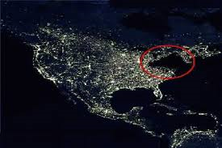
During a Power Outage
Turn off and unplug all unnecessary electrical equipment, including sensitive electronics and appliances (like stoves)
Leave one light turned on so you’ll know when the power comes back on.
Eliminate unnecessary travel, especially by car. Traffic lights will be out and roads will be congested.
Never use a generator, grill, camp stove or other gasoline, propane, natural gas or charcoal-burning devices inside a home, garage, basement, crawlspace or any partially enclosed area. Locate unit away from doors, windows and vents that could allow carbon monoxide to come indoors.
The primary hazards to avoid when using alternate sources for electricity, heating or cooking are carbon monoxide poisoning, electric shock and fire.
Install carbon monoxide alarms in central locations on every level of your home and outside sleeping areas to provide early warning of accumulating carbon monoxide. If the carbon monoxide alarm sounds, move quickly to a fresh air location outdoors or by an open window or door.
Tips and Tricks

Slide 15
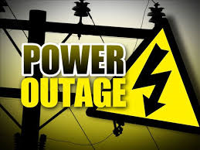
After a Power Outage
If food in the freezer is colder than 40° F and has ice crystals on it, you can refreeze it.
If you are not sure food is cold enough, take its temperature with a food thermometer.
Restock supplies in your Emergency Kit!
Do not touch any electrical power lines and keep your family and pets away from them. Report downed power lines to the appropriate officials in your area.
Throw away any food that has been exposed to temperatures higher than 40° F (4° C) for 2 hours or more, or that has an unusual odor, color or texture. When in doubt, throw it out!
Never taste food or rely on appearance or odor to determine its safety. Some types of bacteria produce toxins that cannot be destroyed by cooking.

Slide 16
Important phone numbers
EMERGENCIES | 911
City of Fairfax Emergency Management | 703-385-4856
Crisislink Hotline | 703-527-4077
Fairfax County Health Department | 703-246-7100
City of Fairfax Police - Non-emergency | 703-385-7924
City of Fairfax Fire Department - Non-emergency | 703-385-7940
Fairfax Volunteer Fire Department | 703-385-7877
The Virginia Relay Center - TTY | 711
The Virginia Relay Center - Voice | 711
City of Fairfax Police Department - Emergency | 911 or 703-591-5511
Salvation Army | 703-385-8700
American Red Cross | 1-866-438-4636
Department of Homeland Security | 1-800-BE-READY
Center for Disease Control | 1-800-311-3435
National Weather Service | 703-260-0809
FEMA Disaster Assistance Hotline | 1-800-621-3362
FEMA Disaster Assistance Hotline - TTY | 1-800-462-7585
FEMA False Claim Reporting | 1-800-323-9603

Slide 17
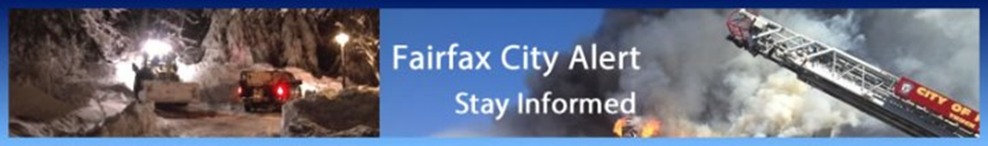
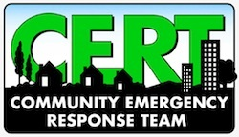
Resources
City of Fairfax Office of Emergency Management
http://www.fairfaxva.gov/government/emergency-management
Fairfax City Alert
http://fairfaxva.gov/about-us/fairfax-city-alert
Ready Virginia
http://www.vaemergency.gov/readyvirginia
Individuals with Disabilities, Access and Functional Needs
https://www.ready.gov/individuals-access-functional-needs
Family Communications Plan
http://www.ready.gov/make-a-plan
Coloring books for Kids
http://www.nssl.noaa.gov/education/students/
Generator Information
http://energy.gov/oe/community-guidelines-energy-emergencies/using-backup-generators-choosing-right-backup-generator-0
Ready.Gov (FEMA)
http://www.ready.gov/
Get Involved!
Find Out More!

