Slide 1
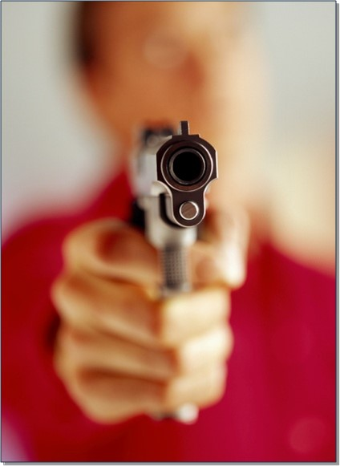
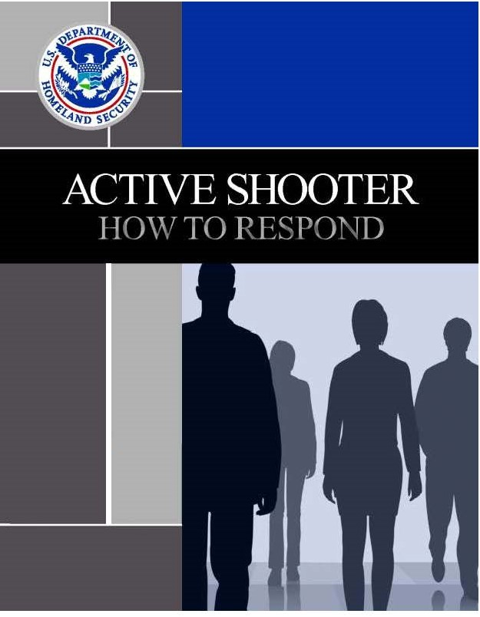
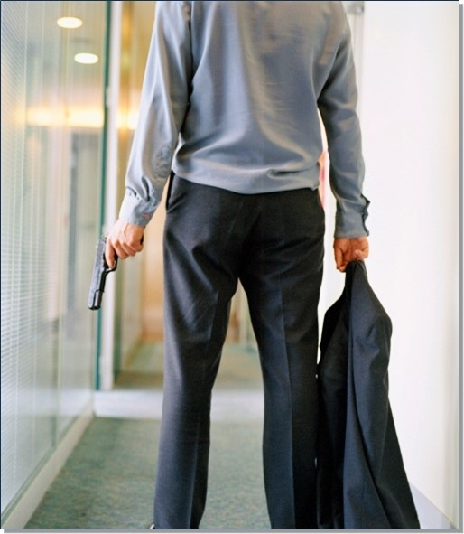

ACTIVE SHOOTER INCIDENTS
Adapted from FEMA’s IS 907: Active Shooter – What can you do?

Slide 2

DISPATCHER:
“911, what is the nature of your emergency?”
CALLER:
“There’s somebody with a gun in the main entrance to the mall and I don’t . . .”
Active shooter situations are unpredictable and evolve quickly.
Are you prepared?
Notes:
Dispatcher: “911, what is the nature of your emergency?”
Caller: “There’s somebody with a gun in the main entrance to the mall and I don’t . . .”
Are you prepared?

Slide 3


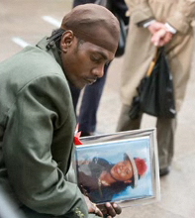
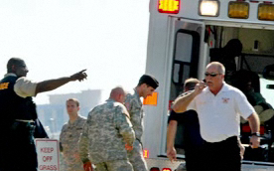
Active Shooter Incidents
Where we:
  Live
  Shop / Entertainment
  Learn
  Work
  Motivated by:
  Anger, revenge, ideology, untreated mental illness
Notes:
During the past several years, there have been many active shooter incidents:
Where we shop. In 2007 a gunman killed 5 and injured multiple others at a Utah mall.
Where we exercise our free speech. In 2011 U.S. Representative Gabrielle (Gabby) Giffords was critically shot while meeting with constituents at a market, with 6 people killed and 3 others injured.
Where we learn.
In 1999 at Columbine High School 12 students and 1 teacher were killed.
In 2007 at Virginia Tech 32 were killed and many others wounded.
In 2008 at Northern Illinois University 5 students were killed.
Where we work. In 2010 a gunman opened fire at a beer distributor, killing 8 people.
Most active shooter situations are unpredictable and evolve quickly. Because most incidents are over within minutes, we must be prepared to deal with the situation until law enforcement personnel arrive.
Preparedness and awareness are the keys to helping protect our employees, our customers, and ourselves.

Slide 4
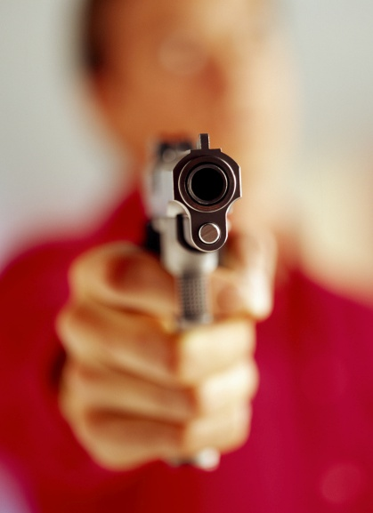
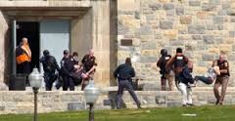
Active Shooter Situations
  More frequent
  Unpredictable
  Evolve quickly
  Continue until stopped by law enforcement, suicide, or intervention
Notes:
An active shooter is an individual actively engaged in killing or attempting to kill people in a confined space or other populated area. In most cases, active shooters use firearms and there is no pattern or method to their selection of victims.
Active shooter situations are unpredictable and evolve quickly.
Active shooters usually will continue to move throughout a building or area until stopped by law enforcement, suicide, or other intervention. Typically, the deployment of law enforcement is required to stop the shooting and to prevent further harm to victims.

Slide 5
City of Fairfax Recommends
When a hostile person(s) is actively causing deadly harm or the imminent threat of deadly harm, the City recommends the following precautions to all employees and visitors. Ultimately, each person is responsible for their own safety and decisions.
  If safe to do so, Dial 911. Report the situation and your location
    Turn on your cell phone and follow instructions from eMAS alerts
  RUN: Evacuate if safe
  HIDE: If you cannot safely evacuate the building, lock yourself in the room you are in, or a room that can be secured and safe
  FIGHT: If you are unable to escape or barricade yourself away from the intruder, you must decide what action to take
  Once the police arrive, obey all instructions
Notes:
*Further information can be found in the City of Fairfax, OEM, Crisis Response Guide
In an active shooter situation, all involved persons should quickly determine the most reasonable way to protect their own lives.
Recommended actions, in order, are:
Run: If there is an accessible escape path, attempt to evacuate the premises.
Hide: If evacuation is not possible, find a place to hide where the active shooter is less likely to find you.
Fight: As a last resort, and if your life is in imminent danger, attempt to disrupt and/or incapacitate the active shooter.
Training is important to enable you to react appropriately if confronted with an active shooter situation. As these situations evolve quickly, quick decisions could mean the difference between life and death. If you are in harm’s way, you will need to decide rapidly what the safest course of action is based on the scenario that is unfolding.

Slide 6
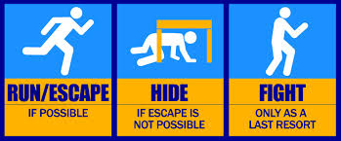
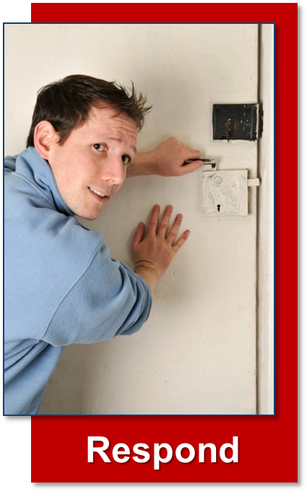
How To Respond
Run
Hide
Fight
Notes:
In an active shooter situation, all involved persons should quickly determine the most reasonable way to protect their own lives.
Recommended actions, in order, are:
Run: If there is an accessible escape path, attempt to evacuate the premises.
Hide: If evacuation is not possible, find a place to hide where the active shooter is less likely to find you.
Fight: As a last resort, and if your life is in imminent danger, attempt to disrupt and/or incapacitate the active shooter.
Training is important to enable you to react appropriately if confronted with an active shooter situation. As these situations evolve quickly, quick decisions could mean the difference between life and death. If you are in harm’s way, you will need to decide rapidly what the safest course of action is based on the scenario that is unfolding.

Slide 7

Notes:
<iframe width="560" height="315" src="https://www.youtube.com/embed/5VcSwejU2D0" frameborder="0" allowfullscreen></iframe>Transcript:
Narrator: It may feel like just another day at the office.
A series of shots shows a standard office. People work at cubicles. One desk has an American flag.
But occasionally, life feels more like an action movie than reality.
A muscular man dressed in all black, wearing sunglasses and carrying a backpack, walks towards the office building. Inside the building, the employees are still going about their daily tasks. A security guard talks with a woman. A visitor greets a staff member.
Narrator: The authorities are working hard to protect you and to protect our public spaces.
Two employees say hello to each other and get into the elevator.
Narrator: But sometimes, bad people do bad things.
We cut back to the sidewalk outside, as we continue to see the man in black approaching the building. As he walks, a series of facts are displayed on the screen.
Caption: 21 killed, 19 wounded at a fast food restaurant. 32 killed, 25 wounded while attending class.
Narrator: Their motivations are different.
Caption: 6 killed, 13 wounded at a shopping center.
The man in black starts up the steps to the glass front doors of the building.
Caption: 13 killed, 29 wounded while at work.
Narrator: The warning signs may vary, but the devastating effects are the same.
The man in black opens the front door of the building. As he enters, we see a notice on the glass prohibiting the carrying of concealed handguns in the building under penalty of trespass.
Narrator: ... and unfortunately, you need to be prepared for the worst.
The camera pans past a series of people at their desks and stops in front of the elevator, where the security guard is talking with an employee. The man in black walks past the guard, removes a shotgun from his backpack, turns around, and shoots the security guard and two employees. More shots are fired. A woman at a photocopier hears the noise and looks around.
Narrator: If you are to ever find yourself in the middle of an active shooter event, your survival may depend on whether or not you have a plan.
The man in black stops shooting in the lobby and starts walking off.
Narrator: The plan doesn't have to be complicated.
A man in a purple shirt looks up, startled. A woman hangs up a phone and looks down the hallway at the commotion.
Narrator: The plan doesn't have to be complicated. There are three things you could do that make a difference: Run. Hide. Fight.
The woman who was on the phone stands up, moves into the hallway, and looks scared. Another woman, wearing pink, sits at her desk with an alarmed look on her face. She then gets out of her chair and moves under her desk.
Narrator: First and foremost, if you can get out, do.
The man in purple starts running down the hallway. He grabs the woman who was on the phone and continues moving towards the exit.
Narrator: Always try and escape or evacuate, even when others insist on staying.
The man in purple and the woman who was on the phone pass the cubicle of the woman in pink. They help her up and the three continue moving towards the exit.
Narrator: Encourage others to leave with you, but don't let them slow you down with indecision.
The man in purple stops, looks around a corner, then continues to lead the two women out. The woman in pink looks very afraid, but the other woman encourages her to keep going. The three employees enter the stairwell and start moving up the stairs.
Narrator: Remember what’s important: you, not your stuff. Leave your belongings behind, and try to find a way to get out safely.
The three employees leave the building through an emergency exit. The camera turns to a mechanical area behind the building, where another man is locking a bicycle to a bike rack.
Narrator: Trying to get yourself out of harm’s way needs to be your number one priority.
The three employees come around a bend and take shelter behind a cinderblock wall protecting mechanical equipment. They are now out of sight of the front of the building and the emergency exit.
The man with the bicycle has headphones off, and walks off, looking at his phone. The man in purple runs out and gets the bicyclist’s attention. One of the women screams "hey" at the cyclist.
Narrator: Once you are out of the line of fire, try to prevent others from walking into the danger zone and call 911.
The man in purple leads the cyclist back to the area where the employees are sheltering. The woman who had been on the telephone calls the police from her cell phone. The woman in pink is still panicking, but remains with the group.
Caption: RUN. When an active shooter is in your vicinity:
· If there is an escape path, attempt to evacuate.
· Evacuate whether others agree to or not.
· Leave your belongings behind.
· Help others escape if possible.
· Prevent others from entering the area.
· Call 9-1-1 when you are safe.
The camera cuts back to the office, where we see the woman who was at the photocopier. She looks out the door, but quickly ducks back into the room.
Narrator: If you can't get out safely, you need to find a place to hide.
The woman from the copier closes the copy room door and looks around the room. The camera cuts to a group sitting in the break room. More shots ring out. The employees in the break room stop talking and begin to look around. They all rise from the table at the same time. A man in a brown suit motions for the group to stay still for a minute, and a woman in red says "oh my gosh." The man in the suit looks out into the hallway and sees other people running at the far end of the hallway. He moves back into the break room and closes the door. Another man, in a blue shirt, signals the others to stay quiet as he and a man in yellow move the table to barricade the door.
Narrator: Act quickly and quietly. Try to secure your hiding place the best you can.
The camera cuts back to the copy room, where the woman at the photocopier moves the machine in front of the door. She then shuts off the lights and pulls out a cell phone.
Narrator: Turn out lights, and if possible, remember to lock doors. Silence your ringer and vibration mode on your cell phone.
The woman in the copy room slides the ringer volume control on her phone to silent, then turns the vibrate mode off. The camera cuts to the shooter, who is walking through a set of cubicles. The employees are all in hiding or have left the building. He reaches for a doorknob, but finds it
locked and moves on.
Narrator: And if you can't find a safe room or closet, try to conceal yourself behind large objects that may protect you.
The camera shows the woman in the copy room crouched in the corner between the wall and the copier, her eyes closed, silent.
Narrator: Do your best to remain quiet and calm.
Caption: HIDE. If an evacuation is not possible, find a place to hide.
· Lock and/or blockade the door.
· Silence your cell phone.
· Hide behind large objects.
· Remain very quiet.
Caption: Your hiding place should:
· Be out of the shooter’s view.
· Provide protection of shots are fired in your direction.
· Not trap or restrict your options for movement.
The music switches from suspenseful to a faster tempo. The camera switches to the break room, where the group of employees realize that they are in trouble.
Narrator: As a last resort, if your life is at risk, whether you're alone or working together as a group, fight! Act with aggression. Improvise weapons. Disarm him.
The employees in the break room try to calm the woman who is panicking, and begin organizing themselves. The man in yellow picks up a chair. He looks apprehensive, but moves towards the door. The panicking woman moves into a corner. The man in brown stands to the side of the door, holding a fire extinguisher above his head, ready to swing. He silently mouths to the others, asking if they're ready.
Narrator: ... and commit to taking the shooter down, no matter what.
The shooter enters the break room holding an assault rifle, and the employees attack. Two employees are holding coffee mugs, while the other two start to swing with the fire extinguisher and chair.
Caption: FIGHT. As a last resort, and only if your life is in danger:
· Attempt to incapacitate the shooter.
· Act with physical aggression.
· Improvise weapons.
· Commit to your actions.
The tempo of the background music slows, as the camera cuts back to the exterior of a building. Three more employees exit, and the group in the mechanical area gets their attention, directing them to the hiding place.
Narrator: Try to be aware of your environment. Always have an exit plan.
The camera cuts back to the interior of the building. The police have arrived. Some are patrol officers, wearing blue uniforms. Others are part of the SWAT team, wearing camouflage fatigues and helmets. All the officers are holding assault rifles. They are entering in a tactical formation, with some officers looking forward while others check to the sides and behind them. They stay as a tight group.
Narrator: Know that in an incident like this, victims are generally chosen randomly. The event is unpredictable and may evolve quickly.
The officers begin entering offices one by one, searching for the shooter. They pass a man lying on the ground, continuing to search for the man in black.
Narrator: The first responders on the scene are not there to evacuate or tend to the injured. They are well-trained, and are there to stop the shooter.
The music changes to a more upbeat, militaristic march. The police continue to do a room-by-room search as they pass by more casualties. Officers check each stall in a bathroom before moving down another hallway.
Caption: 9-1-1. When law enforcement arrives:
· Remain calm and follow instructions.
· Keep your hands visible at all times.
· Avoid pointing or yelling.
· Know that help for the injured is on its way.
The front door of the building slams open and more employees pour out. They are running with their hands in the air, palms facing forward to demonstrate that they are not holding any weapons. A man assists others as they round a bend on an exterior stairwell. We then see a shot of a fire engine parked in front of the building.
Narrator: Your actions can make a difference for your safety and survival. Be aware and be prepared.
More people leave the front door as a firefighter directs them towards a rallying point. More people are running down the exterior stairwell. As he rounds a landing, a man removes his suit jacket, but does not slow down. Other employees, including the group from the break room, are crouched on the ground by the fire engine, out of breath, but uninjured.
Narrator: And if you find yourself faced with an active shooter, there are three key things you need to remember to survive: Run. Hide. Fight.
The camera pans across the employees congregated by the fire engine. Many are talking with one another. Others are on cell phones. A firefighter moves past, giving directions as the screen fades to black.
Caption: "Run. Hide. Fight.: Surviving an Active Shooter Event" is a Department of Homeland Security Grant Funded Project of the Regional Catastrophic Planning Initiative. Produced by the City of Houston Mayor’s Office of Public Safety and Homeland Security. Ready Houston, www.readyhoustontx.gov.
Caption: For more information: www.readyhoustontx.gov.
Screen fades to black.

Slide 8

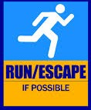
Run (1 of 2)
  Have an escape route and plan in mind
  Leave your belongings behind
  Help others escape, if possible
  Evacuate regardless of others
  Warn/prevent individuals from entering
Notes:
The first recommended action is to run. If there is an accessible escape path, attempt to evacuate the premises.
When running:
Have an escape route and plan in mind.
Leave your belongings behind.
Help others escape, if possible.
Evacuate regardless of whether others agree to follow.
Warn individuals not to enter an area where the active shooter may be.
Prevent individuals from entering an area where the active shooter may be.
(Continued on the following page.)

Slide 9

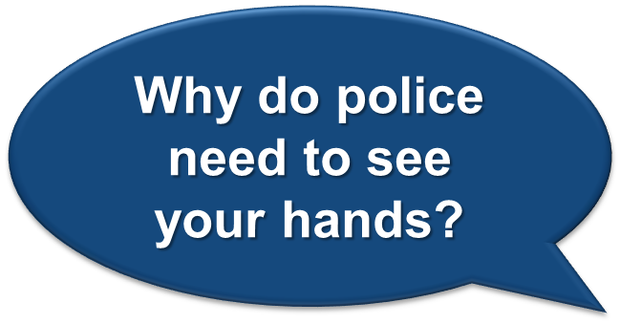
Run (2 of 2)
  Do not attempt to move wounded people
  Keep your hands visible
  Follow police instructions
  Call 911 when safe
Notes:
When running (continued):
Do not attempt to move wounded people.
Keep your hands visible.
Follow the instructions of any police officers.
Call 911 when it is safe to do so.
Why do police officers need to see your hands when you exit the premises in an active shooter situation?

Slide 10

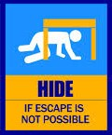
Hide
  Your hiding spot should:
  Be out of the active shooter’s view
  Provide protection if shots are fired
  Not restrict options for movement
Notes:
The next recommended action is to hide. If safe evacuation is not possible, find a place to hide from the active shooter.
The hiding place should:
Be out of the active shooter’s view.
Provide protection if shots are fired (for example, an office with a closed and locked door).
Not restrict options for movement.
To prevent an active shooter from entering a hiding place:
Lock the door.
Blockade the door with heavy furniture. This also provides additional protection.
Close, cover, and move away from any windows.

Slide 11

Keeping Yourself Safe While Hiding
  If the shooter is nearby:
  Lock the door
  Hide behind large item (e.g., cabinet, desk)
  Silence cell phone/pager; lower the brightness of your cell phone if possible
  Remain quiet
Notes:
If the active shooter is nearby, take the following actions:
Lock the door.
Hide behind a large item (for example, a cabinet or desk).
Silence your cell phone and/or pager. (Even the vibrate setting can give away a hiding position.)
Remain quiet.
Consider the difference between cover and concealment. Cover might protect a person from gunfire, while concealment will merely hide a person from the view of the shooter.
Persons in an active shooter situation should quickly choose the best space that is available. Finding cover is preferable, but if cover is not available you should find a position of concealment.

Slide 12
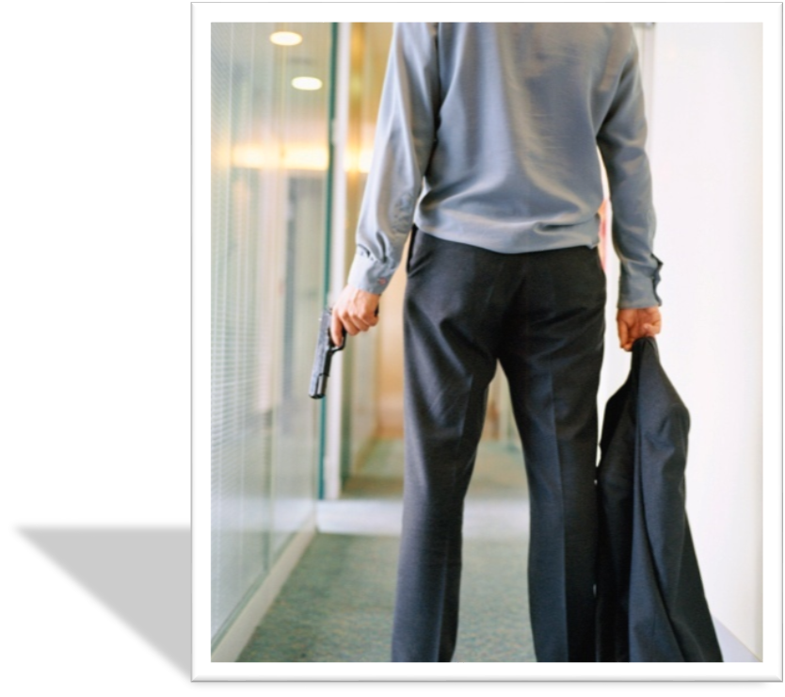
Important Information
Provide law enforcement or 911 operators with:
  Location of shooter
  Number of shooters
  Physical description of shooters
  Number and types of weapons
  Number of potential victims
Notes:
When possible, provide the following information to law enforcement officers or 911 operators:
Location of the active shooter.
Number of shooters, if more than one.
Physical description of the shooter(s).
Number and type of weapons held by the shooter(s).
Number of potential victims at the location.

Slide 13

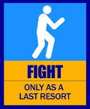
Fight
  As an absolute last resort:
  Act as aggressively as possible
  Throw items and use improvised weapons
  Work together to incapacitate the shooter
  Commit to your actions
Notes:
Finally, as an absolute last resort, and only if in imminent danger, attempt to disrupt and/or incapacitate the active shooter.
Act as aggressively as possible.
Throw items and use improvised weapons.
Work together to incapacitate the shooter.
Commit to your actions.

Slide 14
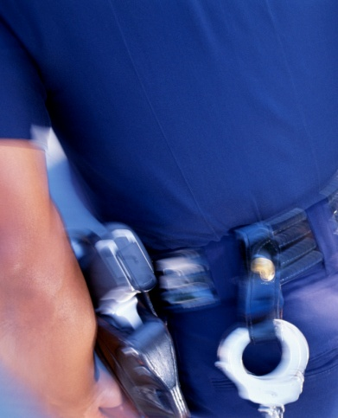
Law Enforcement’s Role
  Immediate purpose:
  Stop the active shooter; first priority is to eliminate the threat
  Proceed to area where last shots heard
  Once the police arrive, obey all instructions. This may involve being handcuffed or putting your hands in the air.
Notes:
When law enforcement officers arrive at an active shooter scene:
Their immediate purpose is to stop the active shooter as soon as possible.
Officers will proceed directly to the area in which the last shots were heard.
The first officers to arrive at the scene will not stop to help injured persons because their first priority is to eliminate the threat. They will need to secure the scene first.
When there is an emergency such as an active shooter incident, it is important to remember that officers arriving on scene may be coming from many different duty assignments and will likely be in various types of uniforms and even in street clothes. Do not be surprised by the variations in appearance, as law enforcement personnel are trained to react quickly and work together.

Slide 15
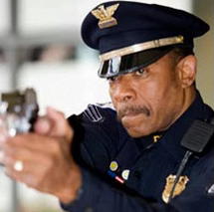
Additional Officers and Rescue Teams
  Teams may:
  Wear bulletproof vests, helmets, and other equipment
  Be armed with rifles, shotguns, and/or handguns
  Use pepper spray
  Shout commands
  Push individuals to the ground for their safety
Notes:
Additional officers may arrive in teams, such as a SWAT (special weapons and tactics) team. These teams may:
Wear regular patrol uniforms or external bulletproof vests, Kevlar helmets, and other tactical equipment. Some officers may be in plain clothes.
Be armed with rifles, shotguns, or handguns.
Use pepper spray or tear gas to control the situation.
Shout commands, and push individuals to the ground for their safety.
Emergency medical personnel will also arrive at the scene. Rescue teams will treat and remove any injured persons. These teams may request able-bodied individuals to assist in removing the wounded from the premises.

Slide 16
Reacting to Law Enforcement
  The FBI and other investigative bodies have repeatedly found that there is no accurate profile of shooters. However, several clear behavioral warning signs have been identified which are cause for concern:
  Threatens harm or talks about killing staff
  Constantly starts or participates in fights; Loses temper or self-control easily
  Assaults others repeatedly
  Possesses weapons or has a preoccupation with them
  Becomes frustrated easily and converts frustration into uncontrollable violence
  If anyone believes that someone is an imminent risk for violent or suicidal behavior, they are directed to dial 911 immediately.
  To report a concern, contact the City Police Department at (703) 385-7924
Notes:
Recommended actions to take when law enforcement officers arrive are listed on the visual.

Slide 17
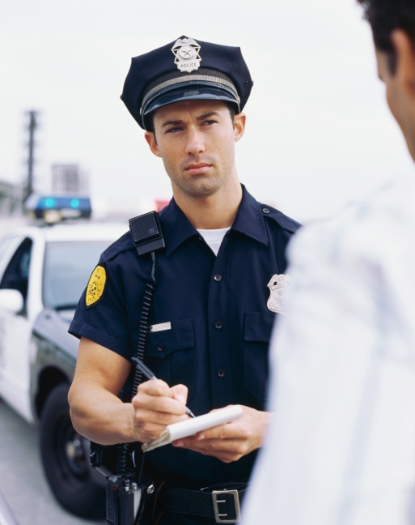
Find a Safe Location
  Area controlled by law enforcement until:
    The situation is under control
    All witnesses are identified and questioned
Notes:
After reaching a safe location or assembly point, all persons involved in the situation likely will be held in that area by law enforcement until the situation is under control, and all witnesses have been identified and questioned.
No one should leave the safe location or assembly point until law enforcement authorities indicate it is safe and their questioning has been completed.

Slide 18
City of Fairfax Guidance
  Lockdown
  Lockdown is used to describe enhanced security measures taken to protect against potentially violent intruders
  All city employees stay in place within department
  Employees remain in locked offices, unobservable from outside (lights-off, window blinds closed, door windows obscured with paper) and outside potential lines of fire
  Employees disregard fire alarms
  No one enters or exits the building, except public safety personnel.

Slide 19
City of Fairfax Guidance
  Secure the Building
  Secure the building if the danger is outside the building (example, a robbery near the building). Outside activities are cancelled; all exterior doors are secured while employees are free to move about inside their building
  No one is allowed outside of the building
  All exterior doors are closed & locked
  Employees will be posted at the building main entrance to control visitor access, issue passes, direct to reunification area if applicable

Slide 20
Important phone numbers
EMERGENCIES | 911
City of Fairfax Emergency Management | 703-385-4856
Crisislink Hotline | 703-527-4077
Fairfax County Health Department | 703-246-7100
City of Fairfax Police – Non-emergency | 703-385-7924
City of Fairfax Fire Department - Non-emergency | 703-385-7940
Fairfax Volunteer Fire Department | 703-385-7877
The Virginia Relay Center - TTY | 711
The Virginia Relay Center - Voice | 711
City of Fairfax Police Department - Emergency | 911 or 703-591-5511
Salvation Army | 703-385-8700
American Red Cross | 1-866-438-4636
Department of Homeland Security | 1-800-BE-READY
Center for Disease Control | 1-800-311-3435
National Weather Service | 703-260-0809
FEMA Disaster Assistance Hotline | 1-800-621-3362
FEMA Disaster Assistance Hotline - TTY | 1-800-462-7585
FEMA False Claim Reporting | 1-800-323-9603

Slide 21
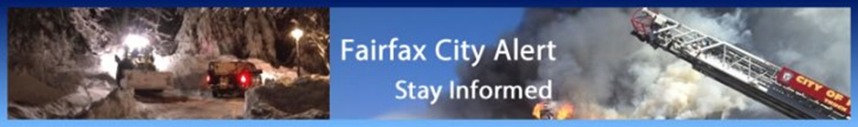

Resources
DHS Active Shooter Webinar
https://share.dhs.gov/asaware2011
DHS Active Shooter Preparedness
http://www.dhs.gov/active-shooter-preparedness
FEMA Active Shooter Independent Study Course
http://training.fema.gov/is/courseoverview.aspx?code=is-907
City of Fairfax Office of Emergency Management
http://www.fairfaxva.gov/government/emergency-management
Fairfax City Alert
http://fairfaxva.gov/about-us/fairfax-city-alert
Ready Virginia
http://www.vaemergency.gov/readyvirginia
Family Communications Plan
http://www.ready.gov/make-a-plan
Ready.Gov (FEMA)
http://www.ready.gov/
Get Involved!
Find Out More!

