Slide 1
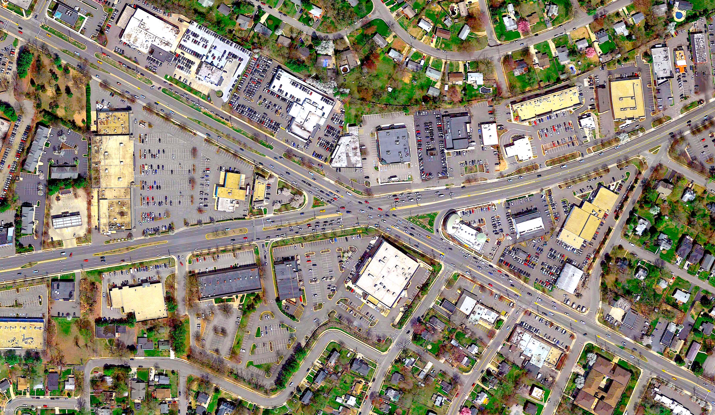


Kamp Washington
Intersection
Improvements
Information Meeting
January 6, 2016

Slide 2

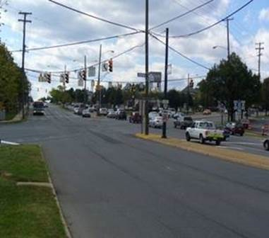

Welcome…
Welcome to the kick-off for the Kamp Washington Intersection Improvements.

Slide 3
Scope of Work
Eliminate horizontal shifts along Fairfax Boulevard/Main Street through the main intersection
Provide an additional southbound lane on Lee Highway from Kamp Washington Intersection to the existing third southbound lane near Shell Station
Extend westbound through lanes on Main Street from Chestnut Street to Hallman Street
Lengthen turn lanes to provide additional storage for turning vehicles
Improve pedestrian mobility with new crosswalks, curb ramps, sidewalks, and pedestrian signalization. Replace span-wire signals with mast arm signals

Slide 4
Benefits of Project
Reduce congestion by improving signal phasing & operation.
Increased capacity of dual left turn lane from east bound Fairfax Boulevard to NB Fairfax Boulevard/Lee Highway.
Improved traffic flow along west bound Main Street
Improved intersection geometrics (elimination of horizontal shifts through intersection along Fairfax Boulevard/Main Street)
Improved pedestrian mobility throughout project limits

Slide 5
Stakeholder Notification
Maintain access to businesses throughout construction and only close one entrance at a time
45 day notices have been sent to businesses and property owners advising them of upcoming work
Provide advance notice and schedule for temporary entrance closings
Install identification signs at business entrances
  Advanced notification for disturbances and parking restrictions
The project website will be updated every Friday by noon www.kampwashingtonimprovements.com

Slide 6
Access Management
Access to businesses will be maintained at all times
Work will be executed in a timely manner to reduce entrance closures
Contractor shall plan work to only close one property entrance at a time
Some work will be performed at night time to reduce impacts

Slide 7
Phase I
Preliminary Schedule:
  January 2016 to January 2017
Install 600 LF of Water Main, 394 LF of Sanitary Sewer, 37 Drainage Structures and 1465 LF of Drainage Pipe
Construct New Sidewalks and Concrete Entrances
Build Roadway Typical
Begin Constructing Traffic Signals (Start April 2016)
    Kamp Washington Intersection
    Chestnut Street
    Maple Street
    CVS Driveway

Slide 8
Phase IA (Route 50 & Service Road)
Preliminary Schedule:
  January 2016 to September 2016

Slide 9
Phase IB (Lee Highway)
Preliminary Schedule:
  July 2016 to January 2017

Slide 10
Phase IC (Main Street)
Preliminary Schedule:
  July 2016 to January 2017

Slide 11
Phase II
  Preliminary Schedule:
  December 2016 to April 2017
Finish Pedestrian Crosswalks
Construct Medians
Finish Traffic Signals
Place Final Course of Asphalt for Entire Project

Slide 12
Phase II (Medians & Final Pavement)
Preliminary Schedule:
  December 2016 to April 2017

Slide 13
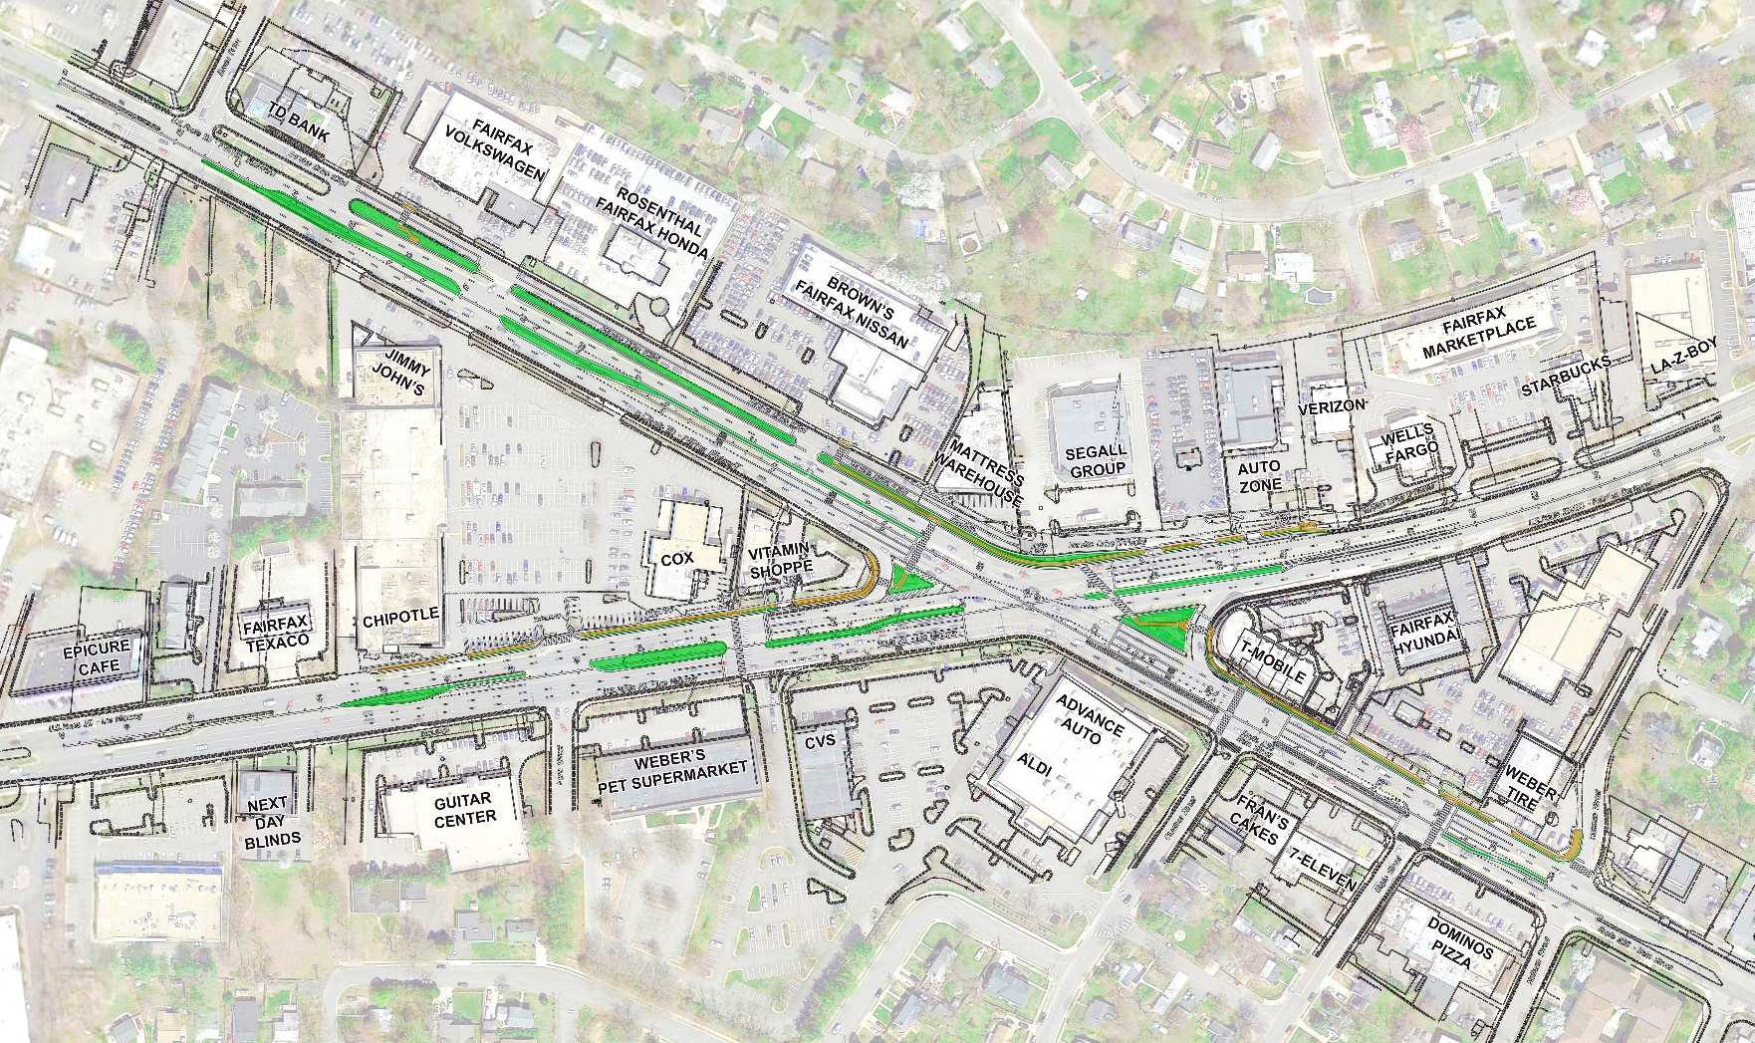
Project Completion

Slide 14
Public Outreach
Visit the Project Website at www.kampwashingtonimprovements.com and City of Fairfax Website at www.fairfaxva.gov
Sign up for Fairfax City Alerts at www.fairfaxva.gov/fairfaxcityalert
E-blasts/List, Notifications, Letters & Flyers
Staff on-site full time to address any concerns or questions

Slide 15
Project Contacts
Michael Wharton – Construction Manager
Michael.Wharton@volkert.com
540-526-7634
Ben Lineberry, Jr. – Project Manager
Ben.Lineberry@volkert.com
540-414-5440
Christina Alexander–Stormwater Resource Engineer, City of Fairfax
Christina.Alexander@fairfaxva.gov
703-273-3067
David Summers-Director of Public Works, City of Fairfax
David.Summers@fairfaxva.gov
703-385-7810

