Slide 1

Kamp Washington Intersection Improvements
City Council Meeting
September 29, 2015
Notes:
FIRST SLIDE

Slide 2
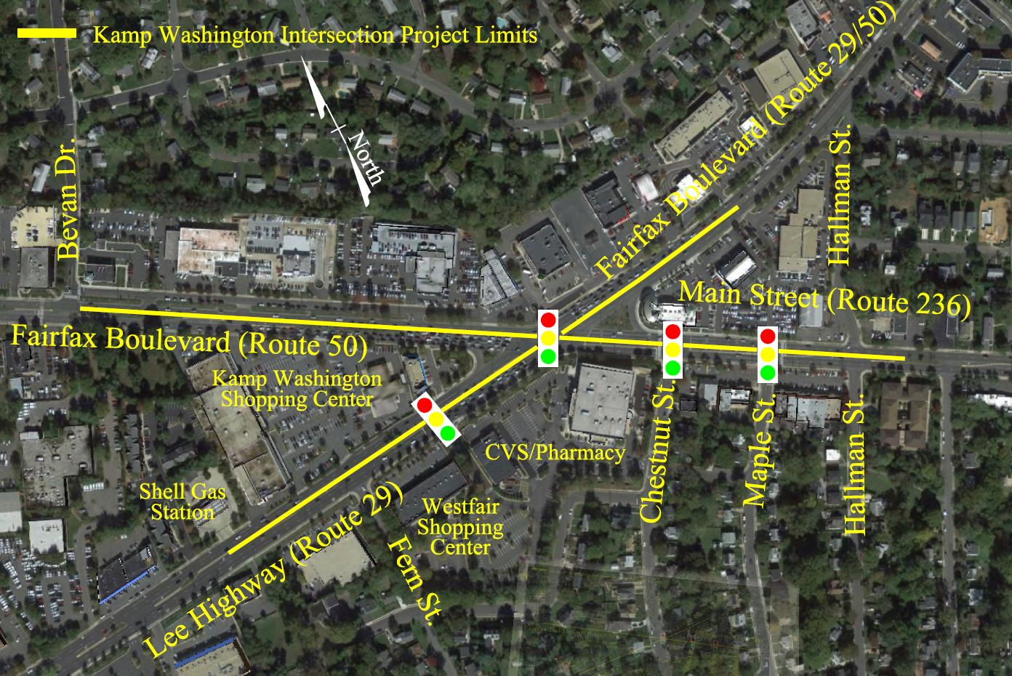
Project Location

Slide 3
Project Scope
Signal improvements
Geometric Improvements
Extension of 3rd southbound through lane (Lee Highway)
Extension of 2nd westbound through lane (Main Street)
Improved pedestrian facilities
Notes:
Signal Improvements: Signalization phasing improvements to optimize operations at the Kamp Washington intersection and replacement of span-wire signals with mast arm signals at 4 locations(Route 29/Route 50/Route 236 intersection, the Route 29/commercial entrance, Route 236/Chestnut St. intersection, and the Route 236/Maple St. entrance)
Geometric improvements: Eliminate the existing substandard lane shift between Route 50 and Route 236 through the intersection. Also, it will allow concurrent dual lefts from Main Street to Lee Highway and from Route 50 south to Route 50 east. Lengthening turn lanes to provide additional storage for turning vehicles from Route 50 to Route 50/29 and Route 236 to Route 29
Southbound Through Lane: Construction of an additional southbound lane on U.S 29 from the Kamp Washington (50/29/236) intersection to the existing third southbound lane near Shell Station
Westbound through lane: on Main Street from Chestnut Street to Hallman Street
Ped Facilities: New crosswalks, curb ramps, sidewalks and pedestrian signalization throughout the project limits

Slide 4
Schedule
Milestone: Date:
Project Start Fall 2007
Preliminary Design 2007-2009
Public Involvement Phase 2009-2011
Right of Way Acquisition Start Spring 2012
Right of Way Acquisition Complete Spring 2014
Final Design Summer 2014
Utility Relocation Start Summer 2014
Advertise for Construction Summer 2015
Construction Start Fall 2015
Construction Complete Fall/Winter 2016

Slide 5
Right of Way Phase Status
19 affected properties requiring acquisition of right of way and/or easements
  No business displacements
Agreement reached on 16 parcels
3 outstanding parcels
  Negotiations ongoing

Slide 6
Project Cost Estimate
  Engineering (PE) : $1.0 M
  Right of Way/Utilities: $4.1 M
  Construction (CN): $6.5 M
  Project Total: $11.6 M

Slide 7
Project Funding
  Federal: $7.2 M
  State: $1.9 M
  NVTA 70% $1.0 M
  Local (General Fund): $0.05 M
  Local (Trans Fund): $1.6 M*
  Total $11.6 M
  * This is the amount of the requested supplemental. City has requested additional NVTA 70% funding to cover a portion of this amount.
Notes:
For now, KW deficit being funded with 30% revenue.
There is sufficient funding in the Transportation Tax Fund to accommodate this in FY 16.
We have purposely left contingency funding in the Transportation Fund for both this project and Northfax due to the uncertainties in right of way and bid prices.
How much 30% do we receive each year?
$2.2M 30%
$2.2M C&I
$4.3 M total in Transportation Tax Revenue per year

Slide 8
Questions / Comments?

